Slide 1
SmartHouse
QOL - Quality Of Life

Slide 2
Outline
Intro
System Overview
OCD
SSS
Data Flow and State Diagrams
STD
Conclusion

Slide 3
Intro - Old System
No voice commands
  No way to have your house immediately apply to your needs
No personal profile
  No way to store personal preferences or privileges to comfort your every day life
No personal schedule
  No way to have your house guide you through the day

Slide 4
SmartHouse
Transition from the overall system to where our component fits into it
DFD-C
DFD-3.4

Slide 5
DFD-3.4.5
Introducing QOL components
QOL DFD-0

Slide 6
OCD-Voice
New features

Slide 7
OCD-Schedule
New features

Slide 8
OCD-Profile
New Features
  Store Preferred Music and Artwork
  Capability to recognize YOUR voice
  Interact with external sound systems and displays
  Separate privileges for guests/kids/owners
  Default settings for new users

Slide 9
SSS-Voice
Major requirement

Slide 10
SSS-Schedule
Major requirement

Slide 11
SSS-Profile
Requirement 3.3.1.8: Privilege Profile Settings
Synopsis: The system shall have a privilege system to authorize commands and determine precedence
Specifics: A user with higher privileges has higher precedence, and preferred artwork takes priority.
Certain privilege levels will be restricted as to what they can change in the system settings.

Slide 12
Diagrams-Voice
DFD
STD

Slide 13
Diagrams-Schedule
DFD
STD

Slide 14
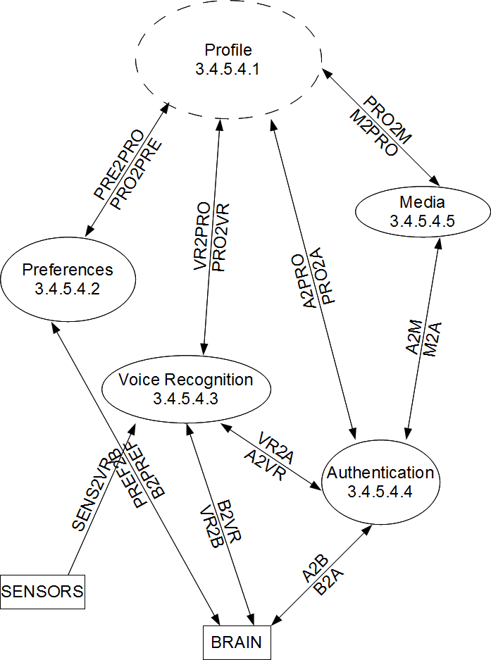
Diagrams Profile
DFD-3.4.5.4

Slide 15
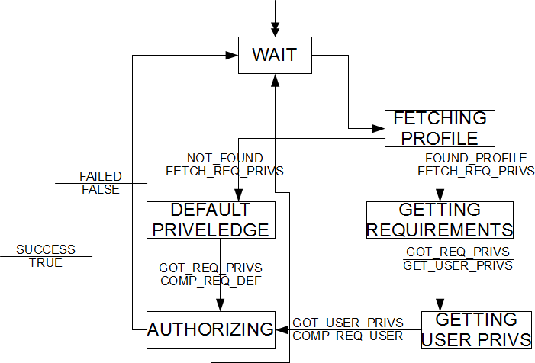
Diagrams Profile
STD-3.4.5.4.4

Slide 16
STD-Voice
Test description

Slide 17
STD-Schedule
Test description

Slide 18
STD-Profile
Preferred Artwork Display
  Condition:
    normal mode + unoccupied state
    Display is off, system is set up for only one room with one screen.
  Input:
    User with stored artwork display preferences enters the SmartHouse
  Expected result:
    The system shall power on the display, then show the user's preferred artwork from the user's profile on the display.

Slide 19
Conclusion
Key feature voice commands
  ...
Key feature personal profile
  Enhanced home atmosphere with automated dynamic display/sound system
  Store preferences for everyone, even guests
Key feature personal schedule
  ...

